Slide 1
Presentation on Software Reliability & Quality
Group 2

Slide 2
Software Reliability

Slide 3
Software Reliability
Software Reliability is the probability of failure-free software operation for a specified period of time in a specified environment.

Slide 4
Software Reliability
Key concepts in discussing reliability:
Fault
Failure
Time
Three kinds of time intervals: MTTR, MTTF, MTBF

Slide 5
Software Reliability
Failure
A failure is said to occur if the observable outcome of a program execution is different from the expected outcome.
Fault
The adjudged cause of failure is called a fault.
Example: A failure may be cause by a defective block of code.

Slide 6
Software Reliability
Time
Time is a key concept in the formulation of reliability. If the time gap between two successive failures is short, we say that the system is less reliable.
Two forms of time are considered.
Execution time (τ)
Calendar time (t)
Clock Time

Slide 7
Software Reliability: Time
Execution Time
The execution time for a software system is the actual time spent by a processor in executing the instructions of the software system.
Clock Time
Clock time includes the wait time of the software system and execution times of other software systems

Slide 8
Software Reliability: Time
Calendar time
Calendar time is the time more commonly understood and followed in everyday life by all, including software engineers and project managers.

Slide 9
Software Reliability: Time Interval
MTTF: Mean Time To Failure
MTTR: Mean Time To Repair
MTBF: Mean Time Between Failures
MTBF = MTTF + MTTR

Slide 10
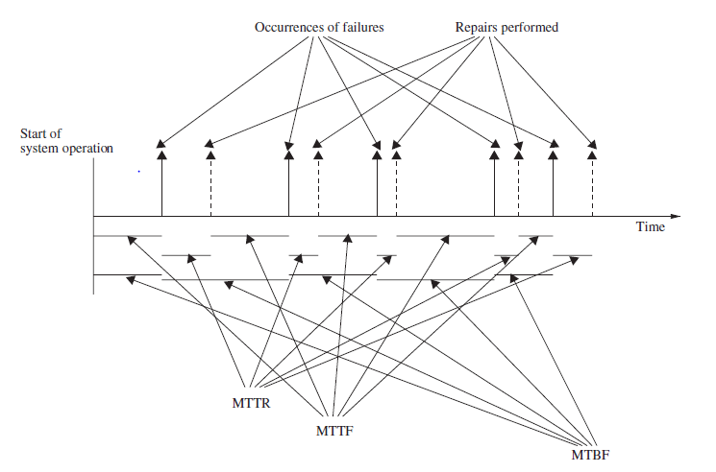
Software Reliability: Time Interval

Slide 11
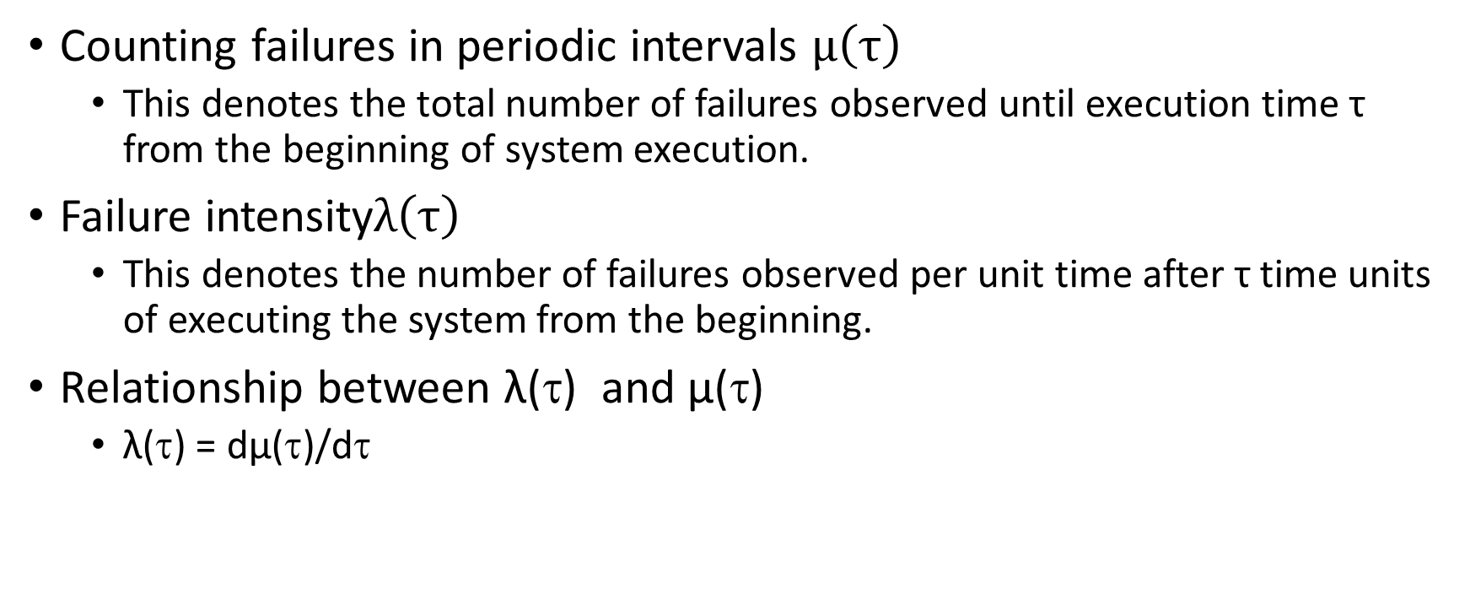
Software Reliability: Time Interval
Counting failures in periodic intervals $µ\left(τ\right)$
This denotes the total number of failures observed until execution time τ from the beginning of system execution.
Failure intensity$λ\left(τ\right)$
This denotes the number of failures observed per unit time after τ time units of executing the system from the beginning.
Relationship between λ(τ) and µ(τ)
λ(τ) = dµ(τ)/dτ

Slide 12
FACTORS INFLUENCING SOFTWARE RELIABILITY
Size and complexity of code
Characteristics of the development process used
Education, experience, and training of development personnel
Operational environment

Slide 13
Applications of Software Reliability
Comparison of software engineering technologies
Measuring the progress of system testing
Controlling the system in operation
Better insight into software development processes

Slide 14
Operational Profiles
Tabular representation
Graphical representation

Slide 15
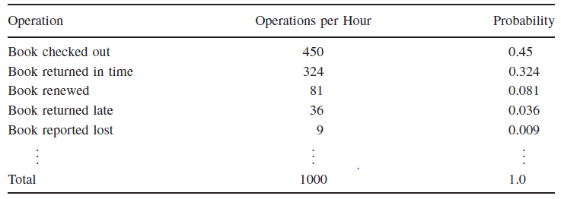
Operational Profiles: Tabular representation

Slide 16
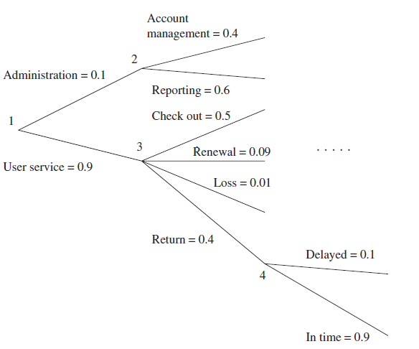
Operational Profiles: Graphical representation

Slide 17
Reliability Models
Basic Model
The decrease in failure intensity after observing a failure and fixing the corresponding fault is constant.
Logarithmic Model
The decrease in failure intensity after observing a failure and fixing the corresponding fault is smaller than the previous decrease.

Slide 18
Reliability Models: Basic assumptions
Faults in the program are independent.
Execution time between failures is large with respect to instruction execution time.
Potential test space covers its use space.
The set of inputs per test run is randomly chosen.
The fault causing a failure is immediately fixed or else its re-occurrence is not counted again.

Slide 19
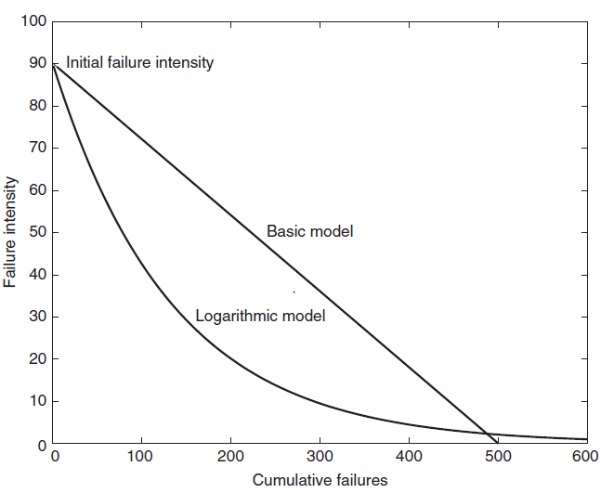
Reliability Models: Parameters of the model
Parameters of the models
λ₀: The initial failure intensity observed at the beginning of system testing.
v₀: The total number of system failures that we expect to observe over infinite time starting from the beginning of system testing.
θ: A parameter representing n0n-linear drop in failure intensity in the Logarithmic model.

Slide 20
MUSA’S BASIC MODEL
Assumption: Decrement in failure function is constant.
intensity
Result: Failure intensity is function of average number of failures experienced at any given point in time (= failure probability).
y=mx+c
f(x)=mx+c
f(µ)=mµ+c=(-λ₀ /V₀) µ+ λ₀
That is
f(µ)=mµ+c=λ₀ (1- (µ /V₀))
λ(μ) = λ ⎡ − ^{μ ⎤}
0 ⎢¹ _{v} ⎥
⎣ 0 ⎦
λ(μ): failure intensity.
λ₀: initial failure intensity at start of execution.
μ: average total number of failures at a given point in time.
v₀: total number of failures over infinite time.

Slide 21
EXAMPLE
•
Assume that we are at some point of time t time units in the life cycle of a software system after it has been deployed.
Assume the program will experience 100 failures over infinite execution time. During the last t time unit interval 50 failures have been observed (and counted). The initially failure intensity was 10 failures per CPU hour.
Compute the current (at t) failure intensity:
•
•
λ(μ) = λ ⎡ − ^{μ ⎤}
0 ⎢¹ _{v} ⎥
⎣ 0 ⎦
Failure per CPU hour
failures
⎤
λ(50) =10⎡1− ^{50 ⎤} = 5⎡
⎢⎣
100 ⎥⎦ ⎢CPU
Hour ⎥
⎣
⎦

Slide 22
Reliability Models
Example
Assume that a software system is undergoing system level testing. The initial failure intensity of the system was 25 failures/CPU hours, and the current failure intensity is 5 failures/CPU hour. It has been decided by the project manager that the system will be released only after the system reaches a reliability level of at most 0.001 failures/CPU hour. From their experience the management team estimates that the system will experience a total of 1200 failures over infinite time. Calculate the additional length of system testing required before the system can be released.
The system will experience a total of 1200 failures over infinite time. Thus, we use the Basic model.
λ_{c} and λ_{r} are the current failure intensity and the failure intensity at the time of release.
Assume that the current failure intensity has been achieved after executing the system for τ_{c} hours.
Let λ_{r} be achieved after testing the system for a total of τ_{r} hours.

Slide 23
Reliability Models
(Example continued)
(τ_{r} - τ_{c}) denotes the additional execution time requires to achieve λ_{r}.
We can write λ_{c} and λ_{r} as follows.
λ_{c} = λ₀.e ^{-λ0 τc/v0}
λ_{r} = λ₀.e ^{-λ0 τr/v0}
λ_{c} / λ_{r} = (λ₀.e ^{-λ0 τc/v0})/(λ₀.e ^{-λ0 τr/v0})
= e ^{(τr - τc) λ0/v0}
ln(λ_{c} / λ_{r}) = (τ_{r} - τ_{c}) λ₀/v₀
(τ_{r} - τ_{c}) = (v₀/ λ₀)ln(λ_{c} / λ_{r})
= (1200/25)ln(5/0.001)
= 408.825 hours
It is required to test the system for more time so that the CPU runs for another 408.825 hours to achieve the reliability level of 0.001 failures/hour.

Slide 24
LOGARITHMIC MODEL
Decrement per encountered failure decreases:
λ(μ) = λ e^{−θμ}
0
θ : failure intensity decay parameter.
Example
λ₀ = 10 failures per CPU hour.
θ =0.02/failure.
–
–
50 failures have been experienced (μ = 50). Current failure intensity:
λ(50) =10e^{(−0.02×50)} =10e⁻¹ = 3.68

Slide 25
Model Extension
Failure intensity as a function of execution time.
For basic model:
λ(τ) =λ e
⎛
λ₀
⎞
τ ⎟
⎜
⎝ 0 ⎠
−
v
0
For logarithmic model
λ₀
λ₀θτ +1
λ(τ) =

Slide 26
Example (Basic Model Extension)
∀ λ₀ = 10 [failures/CPU hour].
v₀ = 100 (number of failures over infinite
execution time).
τ = 10 CPU hours:
⎛
λ₀ ⎞
⎜ − τ ⎟
v
∀
λ(τ) = λ e
⎝ 0 ⎠
0
Failure per CPU hour
⎛ − ¹⁰ ×10 ⎞
⎡
failures
⎤
λ(10) = 10e
⎜ ⎟
⎝
100
⎠
= 10e⁻¹ = 3.68
⎢ ⎥
⎢⎣CPU hour ⎥⎦
∀ τ = 100 CPU hours:
Failure per CPU hour
⎛ − ¹⁰ ×100 ⎞
⎡
failures
⎤
⎜ ⎟
λ(100) = 10e = 10e
−10
100
= 0.000454
⎝ ⎠
⎢ ⎥
⎢⎣CPU hour ⎥⎦

Slide 27
Example (Logarithmic Model Extension)
∀ λ₀ = 10 [failures/CPU hour]. θ = 0.02 / failure.
λ₀
∀ τ = 10 CPU hours: λ(τ) =
λ₀θτ+1
Failure per CPU hour
10
⎡
failures
⎤
λ(10) =
= 3.33⎢
⎥
(3.68 in basic model))
10 × 0.02 ×10 +1
⎢⎣CPU hour ⎥⎦
∀ τ = 100 CPU hours:
⎡
= 0.467
Failure per CPU hour
10
failures
⎤
λ(100) =
10 × 0.02 ×100 +1
⎢CPU hour ⎥
⎢⎣ ⎥⎦
(0.000454 in basic model)

Slide 28
MODEL DISCUSSION
Comparison of basic and logarithmic model:
–
Basic model assumes that there is a 0 failure intensity, logarithmic model assumes convergence to 0 failure intensity.
Basic model assumes a finite number of failures in the system, logarithmic model assumes infinite number.
–
–
–

Slide 29
Software Quality

Slide 30
Quality Assurance
Quality assurance (QA) is a way of preventing mistakes and defects in manufactured products and avoiding problems when delivering products or services to customer.

Slide 31
VIEWS OF SOFTWARE QUALITY
The ﬁve viewpoints help us in understanding different aspects of the quality concept
Transcendental View
User View
Manufacturing View
Product View
Value-Based View

Slide 32
Transcendental View
Quality is something that can be recognized through experience, but not defined in some tractable form.
A good quality object stands out, and it is easily recognized.

Slide 33
User View
Quality concerns the extent to which a product meets user needs and expectations.
This view may encompass many subject elements, such as usability, reliability, and efficiency.

Slide 34
Manufacturing View
This view has its genesis in the manufacturing industry – auto and electronics.
The concept of process plays a key role.
Conformance to requirements leads to uniformity in products. Some argue that such uniformity does not guarantee quality.

Slide 35
Product View
If a product is manufactured with good internal properties, then it will have good external properties.
One can explore the causal relationship between internal properties and external qualities.

Slide 36
Value-Based View
This represents the merger of two concepts: excellence and worth.
Quality is a measure of excellence, and value is a measure of worth.

Slide 37
McCall’s Quality Factors and Criteria
A quality factor represents the behavioral characteristic of a system.
Examples: correctness, reliability, efficiency, testability, portability
A quality criterion is an attribute of a quality factor that is related to software development.
Example:
Modularity is an attribute of the architecture of a software system.

Slide 38
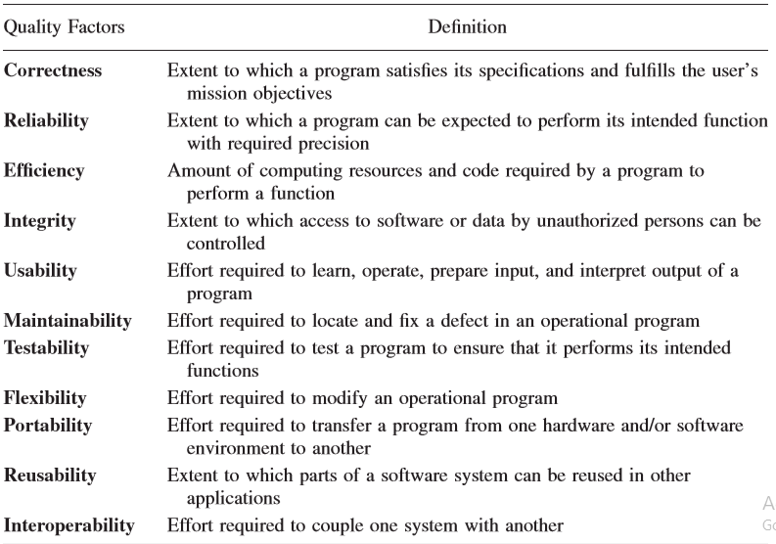
MCCALL’S QUALITY FACTORS AND CRITERIA

Slide 39
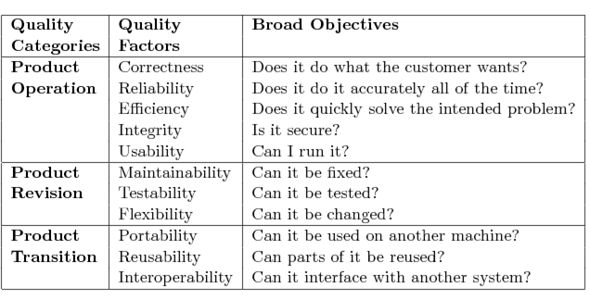
MCCALL’S QUALITY FACTORS AND CRITERIA

Slide 40
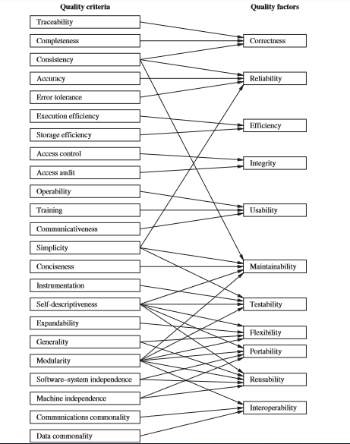
Relation between
quality factors and
quality criteria

Slide 41
APPENDIX

Slide 42
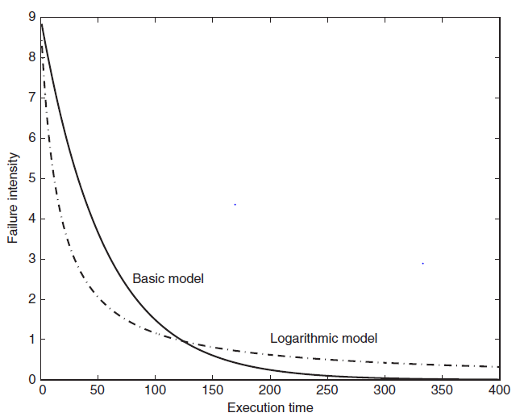
Reliability Models
Basic model
Assumption: λ(µ) = λ₀ (1 - µ/v₀) [y=mx+c]
dµ(τ)/dτ = λ₀ (1 - µ(τ)/v₀)
µ(τ) = λ₀ (1 - µ/v₀)
λ(τ) = λ₀.e ^{-λ0 τ/v0}
Logarithmic model
Assumption: λ(µ) = λ₀e^{-θµ}
dµ(τ)/dτ = λ₀e^{-θµ(τ)}
µ(τ) = ln(λ₀θτ + 1)/θ
λ(τ) = λ₀/(λ₀θτ + 1)

Slide 43
